Slide 1

Computing Eye Tracking Channels
Created by David Grethlein
August 2020
Diagnostic Driving, Inc.
www.diagnosticdriving.com

Slide 2
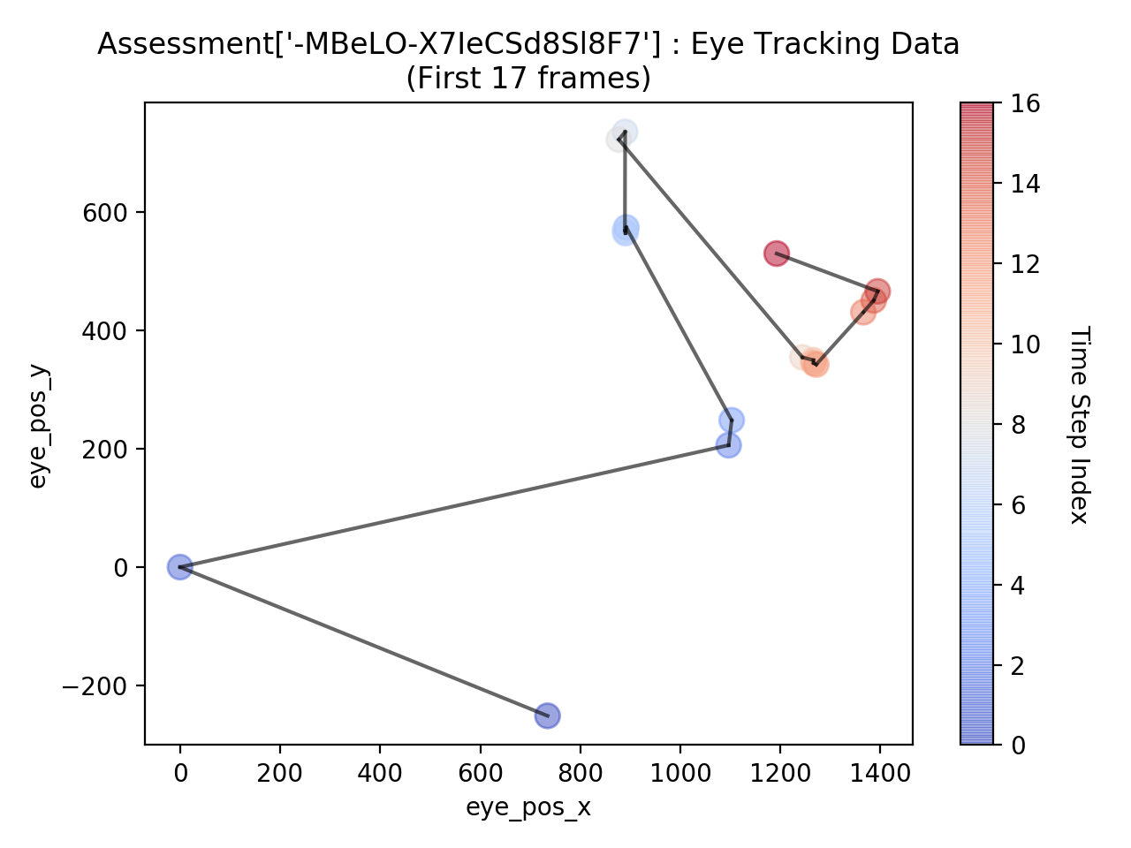

Raw Time Series Data: Position of eye on screen (gaze point) in each frame, down-sampled to 10 Hz in Unity JSON export.
eye_pos_x eye_pos_y
0 734.551514 -251.066238
1 0.000000 0.000000
2 1096.471558 205.801849
3 1102.569580 247.972610
4 891.947021 573.500427
5 890.337280 563.950562
6 889.116028 568.069946
7 889.578125 734.780273
8 877.013611 721.910706
9 1243.987427 354.203613
10 1265.830811 349.413635
11 1266.204468 344.640778
12 1271.535522 342.095184
13 1365.902100 430.459229
14 1386.404175 450.302307
15 1394.482300 465.603058
16 1192.552368 529.379211
Proprietary and Confidential

Slide 3
Saccades
“Quick simultaneous movement of both eyes between two or more phases of fixation…” (Wikipedia)
Take about 200ms to complete.
“In a visually guided saccade, the eyes move toward a visual transient, or stimulus. The parameters of visually guided saccades (amplitude, latency, peak velocity, and duration) are frequently measured as a baseline when measuring other types of saccades. Visually guided saccades can be further subcategorized:
A reflexive saccade is triggered exogenously by the appearance of a peripheral stimulus, or by the disappearance of a fixation stimulus.
A scanning saccade is triggered endogenously for the purpose of exploring the visual environment.”
Proprietary and Confidential

Slide 4
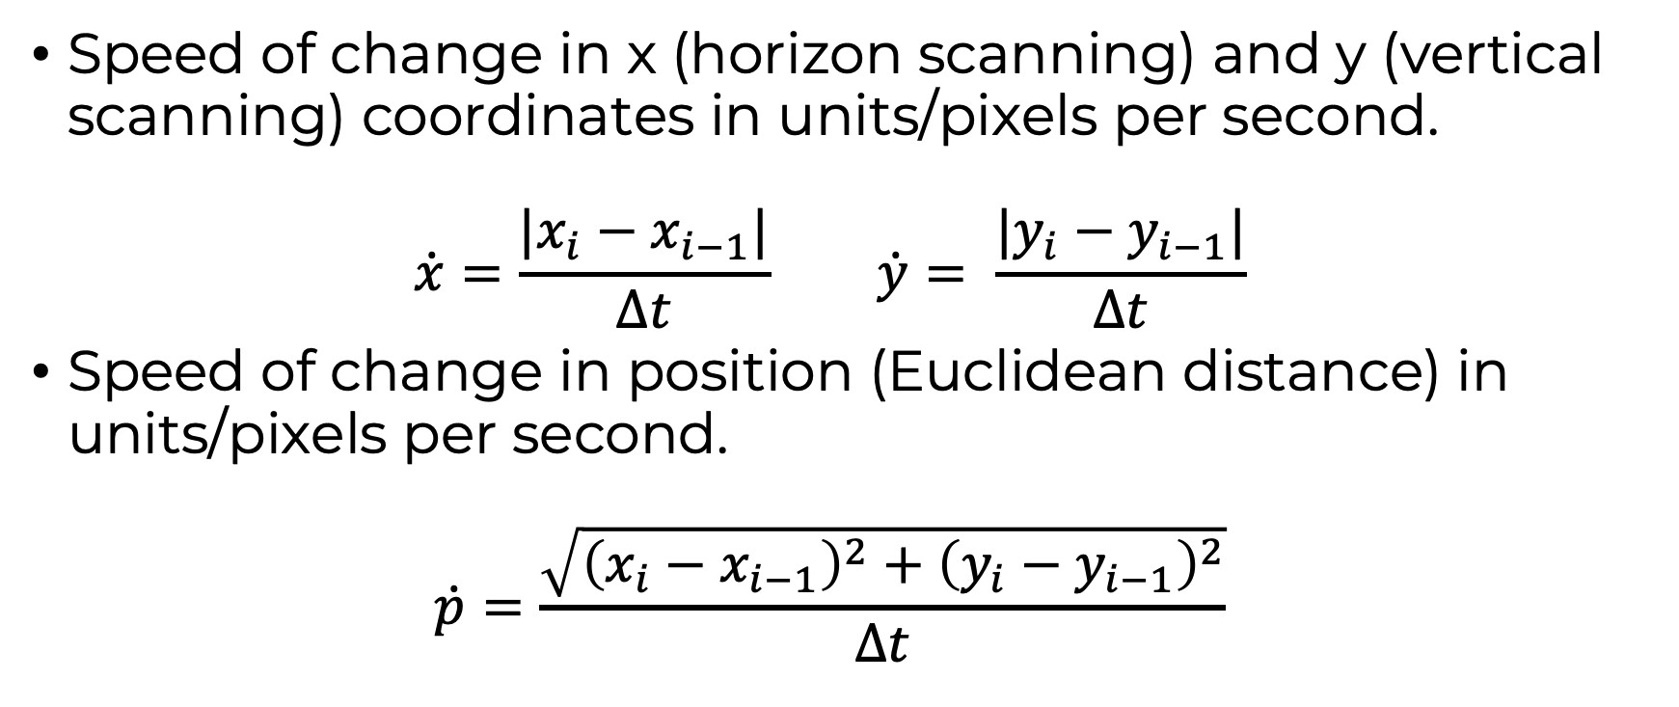





Tracking Change in Gaze Point
Proprietary and Confidential

Slide 5
Measuring constancy of fixation
In any given frame we are interested if the driver is:
maintaining focus on an object
shifting focus to attend to a different object
scanning for new objects as they come into view.
We will construct primitive time series channels to help us measure how erratically the driver’s visual attention is changing in each frame.
Proprietary and Confidential

Slide 6
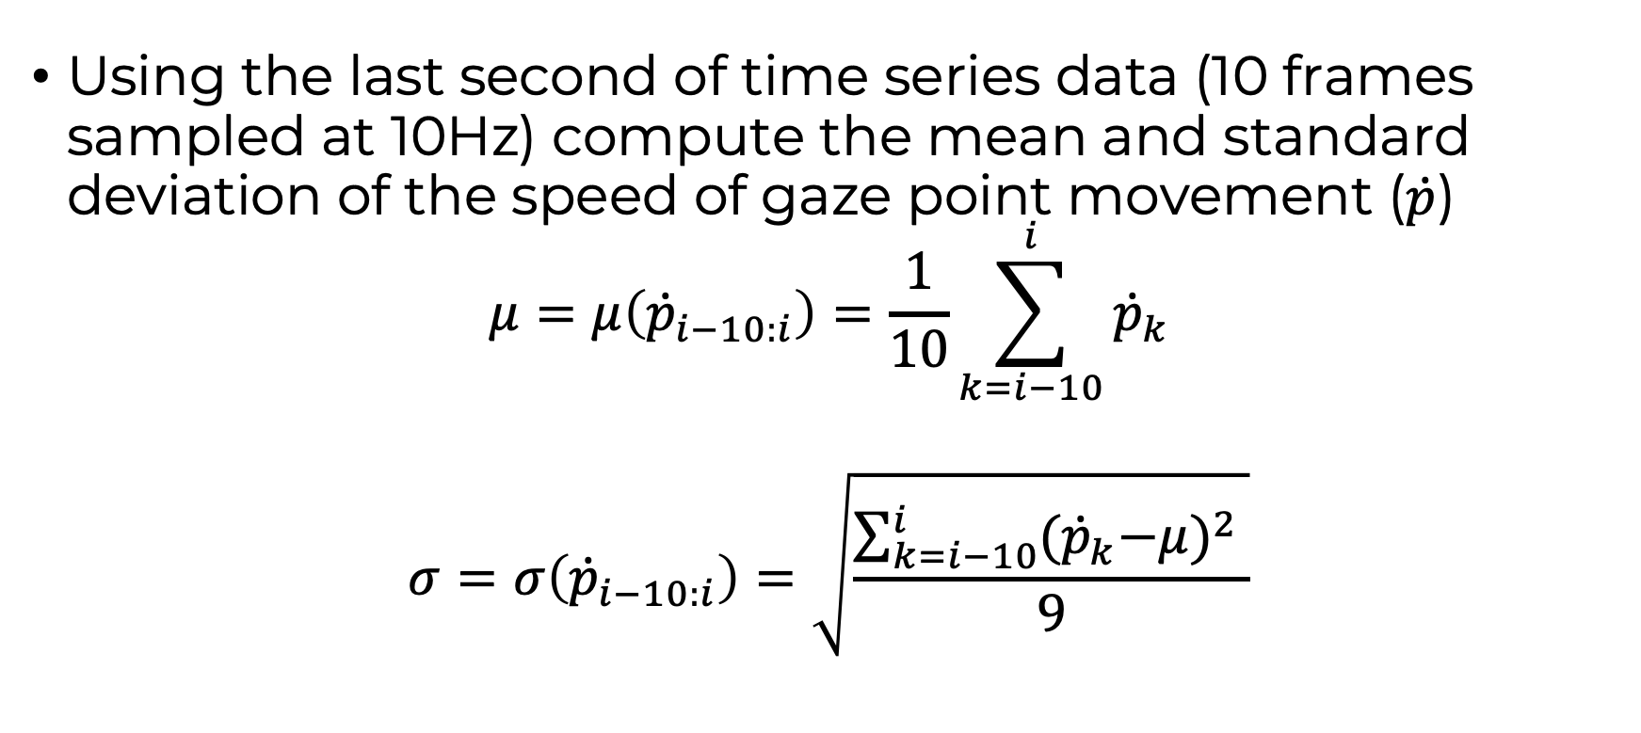
Locally measuring constancy of fixation
(Average speed of position change in last second)
(Uniformity of speed of position changes in last second)
Proprietary and Confidential

Slide 7


Interpreting channel values
large
Sweeping/scanning visual environment
Shifting attention between objects far apart from one another/searching for new objects in view.
Fixating on an object in field of view.
Shifting attention between objects close to one another.
small
small
large
Proprietary and Confidential

Slide 8





Channels Describing Eye Movement
eye_pos_x eye_pos_y eye_delta_pos eye_delta_pos_x eye_delta_pos_y eye_1_sec_mean_delta_pos eye_1_sec_stdev_delta_pos
0 734.551514 -251.066238 0.000000 0.000000 0.000000 0.000000 0.000000
1 0.000000 0.000000 7762.732652 7345.515137 2510.662384 0.000000 0.000000
2 1096.471558 205.801849 11156.183388 10964.715576 2058.018494 0.000000 0.000000
3 1102.569580 247.972610 426.093766 60.980225 421.707611 0.000000 0.000000
4 891.947021 573.500427 3877.244146 2106.225586 3255.278168 0.000000 0.000000
5 890.337280 563.950562 96.845858 16.097412 95.498657 0.000000 0.000000
6 889.116028 568.069946 42.966020 12.212524 41.193848 0.000000 0.000000
7 889.578125 734.780273 1667.109676 4.620972 1667.103271 0.000000 0.000000
8 877.013611 721.910706 179.859054 125.645142 128.695679 0.000000 0.000000
9 1243.987427 354.203613 5194.981110 3669.738159 3677.070923 0.000000 0.000000
10 1265.830811 349.413635 223.624083 218.433838 47.899780 3062.763975 3887.164891
11 1266.204468 344.640778 47.874618 3.736572 47.728577 2291.278172 3606.143012
12 1271.535522 342.095184 59.076382 53.310547 25.455933 1181.567471 1859.510353
13 1365.902100 430.459229 1292.797555 943.665771 883.640442 1268.237850 1840.486737
14 1386.404175 450.302307 285.321373 205.020752 198.430786 909.045573 1610.919092
15 1394.482300 465.603058 173.022853 80.781250 153.007507 916.663272 1606.826536
16 1192.552368 529.379211 2117.618829 2019.299316 637.761536 1124.128553 1615.396497
……………………………………
* All computed channels have 0 imputed for first frame
Proprietary and Confidential

